Slide 1
Module VII
Probabilistic safety assessment
F. Adorján
HAEA (retired)
ferencadorjan@gmail.com
Notes:
There are important additional information given in the Notes section below many of the slides.
In some places, there are cross references, hyperlinks between slides. In such a case the destination slide always has return link, in order to return to the calling point.

Slide 2
Lerning objectives
After completing, module 7 about Probabilistic Safety Assessment the trainee will be able to:
Describe the main purpose of performing probabilistic safety analyses.
Identify the main types and the scopes of probabilistic safety assessments.
Understand the main methodologies used in PSA analyses.
Identify the most important applications of PSA

Slide 3
Contents
Introduction
PSA scope and levels
Full power PSA Level 1 for internal initiators
Level 2 PSA
Level 3 PSA
PSA for external and internal hazards
Low power and shut-down PSA
PSA applications

Slide 4
INTRODUCTION
Learning objectives
After completing this chapter, the trainee will be able to:
Describe the main purpose of performing safety analyses.
Identify the main types and the scope probabilistic safety assessment.
Describe the general objective and value of probabilistic safety assessments.

Slide 5
Purpose of safety analyses
5
The Safety Fundamentals publication, Fundamental Safety Principles, establishes principles for ensuring the protection of workers, the public and the environment, now and in the future, from harmful effects of ionizing radiation.
As already stated in Module VI, the safety analyses are undertaken as a means of evaluating compliance with safety principles and safety requirements for all nuclear facilities.

Slide 6
Purpose of safety analyses
Safety analyses are analytical studies aimed at demonstrating that safety requirements are met for all possible operating conditions of a nuclear facility, in our case of a nuclear power plant, for various postulated initiating events.
This Module covers probabilistic safety analysis or also called as probabilistic safety assessments (PSA), as well as probabilistic risk assessment (PRA).
Notes:
As already stated in Module VI, the safety analyses are analytical studies aimed at demonstrating that safety requirements are met for all possible operating conditions of a nuclear facility, in our case of a nuclear power plant, for various postulated initiating events

Slide 7
Nature of probabilistic safety analysis (PSA)
7
Probabilistic safety analysis is a comprehensive structured approach to identifying all failure scenarios and is a mathematical tool for deriving numerical estimates of risk.
Three levels of PSA are generally recognized.
  Level 1 comprises the analysis of plant failures leading to the determination of core damage frequency.
  Level 2 includes the analysis of containment response leading, together with Level 1 results, to the determination of containment release frequencies.
  Level 3 includes the analysis of off-site consequences leading to estimates of risk to the public and the environment.
Notes:
All of these concepts will be discussed in detail later on.

Slide 8
Scope and goals of PSA
8
The main goal of PSA is to give for all modes of operation, including shutdown:
  assurance that the design is balanced, i.e. no particular feature or PIE makes a disproportionately large contribution to the overall risk;
  assurance that small deviations in plant parameters that could give rise to large variations in plant conditions (cliff-edge effects) will be prevented;
  comparison of the results of the analysis with the acceptance criteria for risk or to probabilistic goals where these have been specified.
Notes:
The source of these is SSR 2/1 5.76.
Mentioning of “plant states” by the textbook is incorrect, since the term is defined for different purposes in different way..

Slide 9
Requirement for both DSA and PSA
9
Both deterministic and probabilistic safety analysis shall be used in a safety analysis of the design of nuclear power plants to enable the challenges to safety in the various categories of plant states to be evaluated and assessed.
Such analyses are an integral part of any licensing process and part of the Final Safety Analysis Report (FSAR) for every nuclear power plant.

Slide 10
Value of PSA
10
The general objective of a PSA is to evaluate the probability that an installation will be the origin of serious consequences.
Since the first application of PSA, it appeared that its value is not only to estimate the overall risk, but also (and mainly) to provide insights into plant design:
  safety performance and
  environmental impacts,
  the identification of dominant risk contributors and
  the comparison of options for reducing risk.
PSA provides a consistent and integrated framework for safety related decision-making.

Slide 11
PSA SCOPE AND LEVELS
11
Learning objectives
After completing this chapter, the trainee will be able to:
Define the scope of probabilistic safety assessments.
Define Level 1, 2 and 3 of probabilistic safety assessments.
Name plant states for which probabilistic safety assessments are performed.
List which initiating events and hazards have to be taken into account when performing probabilistic safety assessments.

Slide 12
Level 1 PSA
In international practice, in the case of nuclear plants safety, three levels of PSA are generally recognised:
  In Level 1 PSA the design and operation of the plant are analysed to identify the sequences of events that can lead to core damage and the core damage frequency is estimated (CDF).
  Level 1 PSA provides insights into the strengths and weaknesses of the safety related systems and procedures to prevent core damage.
Notes:
Main source: SSG-3

Slide 13
Level 2 PSA
In Level 2 PSA the chronological progression of core damage scenarios, identified in Level 1 PSA, is evaluated, including quantitative assessment of the phenomena. It identifies ways in which releases of radioactive material from fuel can result in releases to the environment.
It estimates the frequency, magnitude and other relevant characteristics of the different release categories of radioactive material to the environment.
This analysis provides insights into the relative importance of accident prevention and mitigation measures and of the physical barriers (e.g.: the containment building).

Slide 14
Level 3 PSA
Level 3 PSA estimates the public health and other societal consequences such as the contamination of land or food from the accident sequences that lead to a release of radioactivity to the environment.
It gives insight into the appropriateness of the emergency preparedness programs and planned methodologies.
Notes:
This level is rarely completed due to the lack of necessary reliable information. This level should include the efficiency of the emergency preparedness actions including all of the dependences of these actions.

Slide 15
Scope of PSA
Level 1 PSA, Level 2 PSA and Level 3 PSA are performed sequentially, where the results of each assessment serve as a basis for the PSA at the subsequent level.
SSG-3 provides recommendations towards the scope of PSA: “… in order to use the PSA results for the verification of compliance with existing safety goals or criteria, a full scope PSA involving a comprehensive list of initiating events and hazards and all plant operational modes should be performed …”.
Notes:
In practice, the “Full scope PSA” doesn’t include the Level 3, however it includes the other two levels, the low power and shut-down PSA, as well as the PSA evaluating the external and internal hazards.

Slide 16
Scope of PSA ‒ cont.
The scope of PSA can be specified in three-dimensions:
First of all, depending on the consideration of the extent of accident scenario development, Level-1, Level-2, and Level-3 PSA are distinguished.
Next, the scope of initiating events and hazards may include internal initiating events caused by random components failures and/or human errors, internal hazards such as fires and floods, and external hazards, both natural (such as earthquake) and human-induced (e.g. airplane crash).
In addition, the analysis can be conducted for full power operating conditions as well as for low power and shutdown operating modes of the plant.
Notes:
Figure 2.1 illustrates the overall possible scope of PSA. It is three-dimensional. First of all, depending on the consideration of the extent of accident scenario development, Level-1, Level-2, and Level-3 PSA are distinguished. Next, the scope of initiating events and hazards may include internal initiating events caused by random components failures and/or human errors, internal hazards such as fires and floods, and external hazards, both natural (such as earthquake) and human-induced (e.g. airplane crash). In addition, the analysis can be conducted for full power operating conditions as well as for low power and shutdown modes of the plant.

Slide 17
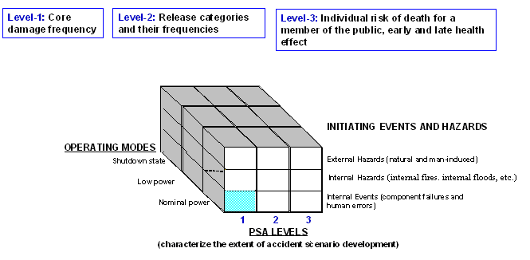
Scope of PSA ‒ cont.
Q
◄
Notes:
When this slide is called from an other slide, click to the sign ◄ to return to the slide last seen!
The big Q at the lower right corner of the slide is a hyperlink to the Discussion questions slide. There is also a RETURN link on the Questions slide, as well.

Slide 18
FULL POWER PSA LEVEL 1 FOR INTERNAL INITIATORS
18
Learning objectives
After completing this chapter, the trainee will be able to:
Define PSA Level 1 objectives.
Describe the concept of fault trees.
Describe the concept of event trees.
Describe the concept of common cause failures and human reliability analysis.

Slide 19
Use of PSA information
A PSA Level 1 gives the information that is very useful to analyse the safety of the nuclear plants, including:
  The dominant accident sequences leading to core damage;
  Systems, initiating events, components and human actions that are important for safety and their importance measures;
  Important dependencies between systems, components, and human actions;
  Impact of different uncertainties on the estimates and insights.
The full power level 1 PSA (FP PSA) have now been carried out for most nuclear power plants, worldwide.

Slide 20
Internal initiators
PSA for nominal power for internal initiating events (IE) highlighted on Figure 2.1 usually receive the most attention, and their frequencies are generally less difficult to estimate than the frequencies of IEs induced by internal and external hazards.
The determination of internal IEs is typically based on the operating experience and engineering analyses.
In addition, the model for Level-1 PSA for internal IEs serves as a basis for PSA for the hazards of other types, other operational modes and levels.
Notes:
You can call the Figure 2.1 by clicking on the link.
The numbering of the Figures refers to the Textbook.

Slide 21
The essence of level 1 PSA
Since the aim of a PSA is to assess the probability of rare events where no direct statistics is available, the general approach is to consider the result as a combination of events with an observable frequency.
More precisely, the core damage event is considered to be the result of diverse combinations of hardware and/or human failures, of which the probabilities can be estimated. .
The general PSA approach is then to identify all credible event sequences that could lead to core damage and to evaluate their frequency, relying on the basic event probabilities.

Slide 22
Steps of level 1 PSA
The steps of the study are the following (see the following figure):
  Identification and grouping of initiating events;
  Definition and modelling of event sequences;
  Systems analysis;
  Collecting and estimating the necessary data;
  Analysis of dependent failures, common cause failures and human reliability;
  Model Integration and Quantification;
  Analysis and Interpretation of results.

Slide 23
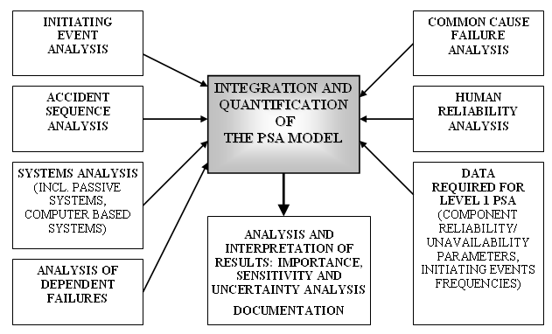
Level 1 PSA process

Slide 24
Identification and grouping of initiating events
The starting point of Level 1 PSA is the identification of the set of initiating events and grouping of initiating events.
An Initiating Event (IE) is defined as an event which creates
a disturbance in the plant and has the potential of leading to core damage, depending on the successful operation of the mitigating functions in the plant.
For the PSA purposes, the initiating events are generally classified into internal IEs and IEs caused by Internal or External hazards.
Internal IEs are all plant events due to random equipment failures or to human errors.
The loss of off-site power, other than those cases that are directly caused by specific external hazards, is also generally considered within the group of internal IEs.
Notes:
This definition of IE (2nd paragraph) is specific for Level 1 PSA, since here the only goal is to determine the core damage frequency. If other release cases are also to be identified, then the IE has to be defined in a more general way.

Slide 25
Initiating events identification and grouping ‒ cont.
The main objectives of the initiating events analysis are as follows:
  To identify a reasonably complete set of the events that require successful mitigation to prevent core damage, so that no significant contributor to core damage is omitted;
  To group initiating events to facilitate the efficient modelling of plant response and the assessment of the frequencies of initiating events. The grouping also may provide facilitation regarding the modelling of accident sequences;
  To provide estimates for the frequencies of the initiating event groups using information available and associated estimation techniques.
Notes:
The facilitation of modelling means that events included in the same group have similar mitigation requirements, or are bounded by the limiting mitigation requirements for the ‘representative initiating event’ for the group.

Slide 26
Initiating events identification and grouping ‒ cont.
Initiating events are grouped in a single group only when the following can be assured:
  Events have the same safe and unsafe end states and lead to similar accident progression in terms of plant response, success criteria, timing, and the effect on the operability of relevant mitigating systems and operators performance; or
  Events can be subsumed into a group and bounded by the worst case impacts within the group.
A representative IE for further modelling of each IE group should be selected.
The different IE groups are characterized by different expectations on plant performance, safety functions, and possibilities for recovery.

Slide 27
Accident sequences analyses
Once initiating events have been identified and grouped, it is necessary to determine the response of the plant to each group of initiating events.
This modelling of responses results in the generation of accident (or event) sequences.
The classical method for the event sequences definition is the conventional event tree method.
For reference, this is a logical method consisting of taking an initiating event and systematically envisaging the success or failure of all the systems and functions liable to play a role during the accident situation.

Slide 28
Accident sequences analyses ‒ cont.
Each branching through the tree represents an accident sequence which is then analysed to determine which branches lead to core damage and the exact natures of the missions of the systems involved.
The definition of the mission of a system constitutes the criterion of success (for example the number of trains necessary), the time of the mission, the time limit for taking human action etc., that is to say all the information necessary for subsequently calculating a probability of failure.
An example of a simple event tree consisting of initiating event (I), modelling functions (A, B and C), successful (OK) and unsuccessful (CD) end states is given in the following figure.

Slide 29
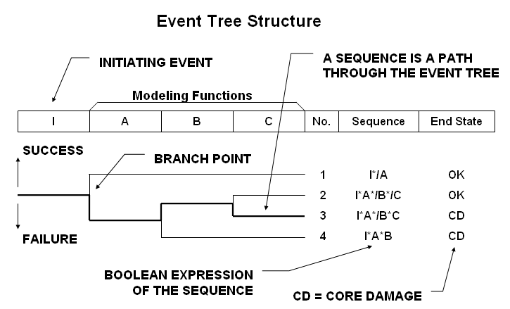
Event tree structure
◄
Notes:
An example of a simple event tree consisting of initiating event (I), modelling functions (A, B and C), successful (OK) and unsuccessful (CD) end states is given on Figure 3.2.
In the Boolean expression the symbol “*” means AND, “+” means OR and “/” means negation. The TRUE value of the modelling functions corresponds to FAILURE.
When this slide is called from an other slide, click to the sign ◄ to return to the slide last seen!

Slide 30
Systems analysis – fault trees
Once the response of the plant to an initiating event has been modelled, the events that constitute the event sequences need further analysis.
The main events are the success or failure of the applicable systems.
The failure of the system is determined from a logical model called a fault tree (see the next figure), which express the system’s failure as a logical combination of the failures of its components and supporting systems.

Slide 31
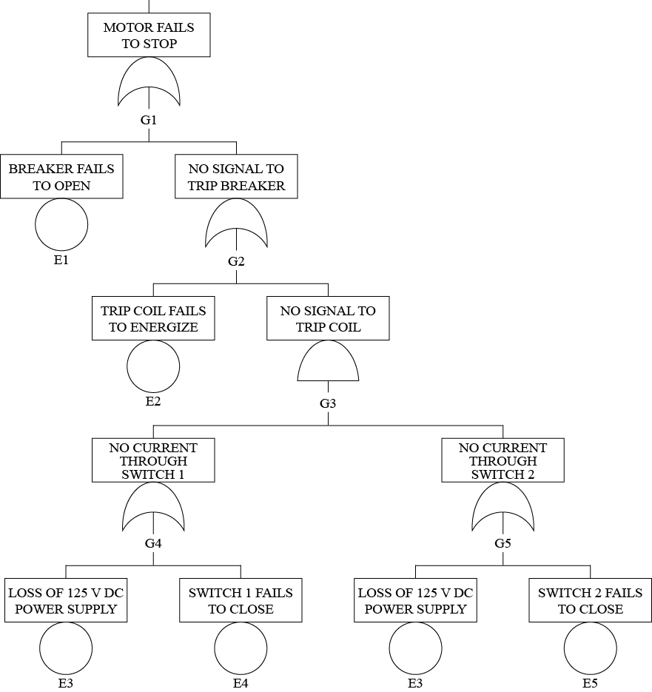
Example of a fault tree
Top event
Basic events
◄
Notes:
For a particular event called the top event (usually a failure of a system to perform some extended function), a fault tree is used to identify the combination of basic events (typically component failures or operator errors) that could lead to the top event. Due to the fact that the safety systems are usually redundant, it is important to take into account common mode failures that are simultaneous failures of multiple components due to some underlying common cause such as design errors, environmental or other factors.
Click to the sign ◄ to return to the last seen slide!

Slide 32
Accident sequences analyses
The modelling task of accident sequences needs particular efforts in very different fields.
The next figure shows the interrelations between initiating event, event trees, fault trees, basic events*, etc. that jointly constitute the PSA model.
A special effort should be made to create scenarios that are as complete and realistic as possible.
The event trees construction is a particularly important task of the PSA, since it is the basis of the whole model.
* Component or human failure, e.g. a valve fails closing, or the operator fails doing an action when required.
Notes:
Also note, that in the modeling any unnecessary or unjustifiable conservatism should be avoided, since such conservative assumptions may significantly distort the PSA results.

Slide 33
Interrelation between different PSA elements and the event tree
Fault tree
◄

Slide 34
Systems analysis
For the top event (usually a failure of a system to perform some safety function), a fault tree is used to identify the combination of basic events (usually component failures or operator errors) that could lead to the top event.
Since the safety systems are usually redundant, it is important to take into account common mode failures that are simultaneous failures of redundant components due to some common cause such as design errors, environmental or other factors.
The systems to be analysed may either be involved in accident sequences (i.e. the branching points of event trees) or in initiating events.
In a given event sequence a system may have several different missions with different success criteria.

Slide 35
Systems analysis ‒ cont.
The first step of system analysis is a very good understanding of the system operation as well as the operation of its components and the effect of their failure on system success.
Such understanding can be achieved through a qualitative analysis, e.g. a failure modes and effect analysis (FMEA) .
After the qualitative step, system analysis is carried out using a logic model enabling calculation of the probability of failure of each mission of the system on the basis of failure probabilities of its basic components.

Slide 36
Systems analysis ‒ cont.
Fault tree analysis is the most common method used for representing the failure logic of plant systems.
It is a deductive failure analysis that is an analytical technique, whereby the undesired state of a system is specified and the system is then analysed in the context of its environment and mode of operation to find all credible ways in which the undesired state could be brought about.
Notes:
Techniques for fault tree construction and quantification can be found in several references, for example IAEA 50-P-4 and
NUREG-0492.
Several other models are available, e.g. state graphs, Petri networks.

Slide 37
Parameter estimation – input data
After the construction of the logic models (event trees - fault trees), and in order to quantify these models, the numerical values of the necessary parameters has to be determined.
The data necessary for quantification can be grouped into the following categories:
  Frequency of initiating events;
  Reliability/unavailability data of components;
  Common Cause Failure (CCF) data.
Notes:
In practice, for an NPP tens or hundreds of thousands of data items are necessary to fill the model with data. Since, many components are commercial products, several of the data items may be identical when they are related to the same model of a given component type (e.g. valve, pump, breaker, etc.). However, even data representing identical components may differ, if the given components are used in highly different environment.
Note, that the quality of a given PSA model is characterized both by the correctness and elaborateness of the logical mode and by the quality of the parameters.

Slide 38
Parameter estimation ‒ cont.
Frequency of IEs:
In so far as possible, operational experience should play a key role in quantification of initiating events frequencies.
There are analytical approaches (Bayesian analysis) that allow plant-specific operational data to be combined with other generic information.
Reliability data of components:
The reliability parameters that are used in the PSAs are typically the following:
  a) Failure rate to run (for a component in operation);
  b) Failure upon demand or failure to start a component in stand-by;
  c) Failure rate during stand-by;
  d) Repair rate or repair time;
  e) Unavailability for maintenance or for testing.

Slide 39
Parameter estimation ‒ cont.
If the specific experience feedback is not available, other information sources can be used, for example international data banks or data used in other PSAs.
However, the applicability of such data to the plant under consideration has to be analysed.
Specific data can be aggregated with generic data using Bayesian methods.

Slide 40
Common cause failures (CCF)
CCFs are failures due to the same cause that can affect redundant components simultaneously, or within a short period of time.
CCFs have to be considered in PSA, since their impact on top events is significant, especially in case of redundant systems.
The CCFs can result, for instance, from design error, fabrication or installation, or from the effects of the environment (normal or accident condition).
If the identified common points (e.g. common support systems) are explicitly introduced in the system models then they are not treated as CCFs.
Notes:
A typical example would be the failure of several pumps due to an inappropriate lubrication.
The CCFs are treated by heuristic methods, providing rough estimations for the effect of potential common causes. This cannot be treated in other way for most of the cases, since the real common causes are hidden. Should they be discovered, they shall be eliminated (e.g. design or maintenance error).

Slide 41
Human reliability analysis (HRA)
Another type of data that are required for PSA is the human reliability data.
However, these data are obtained in the course of Human Reliability Analyses rather than from the statistical treatment of the events from plant operational experience.
The objective of the human reliability analysis is to incorporate in the PSA model the impact of plant personnel actions on risk.

Slide 42
Human reliability analysis (HRA) ‒ cont.
The human errors considered are of three types [IAEA 50-P-4]:
  Human errors made before the occurrence of the initiating event that have the potential to lead to failure or unavailability of safety related equipment (usually referred to as Type A human interactions).
  Human errors that could lead to an initiating event (Type B human interactions).
  Human errors that can be made by plant operators while carrying out actions after the occurrence of an initiating event (Type C human interactions).
The human failure events should be either incorporated in fault trees as event tree headings or used as basic events.

Slide 43
Human errors - Type A
Pre-accident human errors
A systematic review of plant procedures should be carried out to identify the repair, maintenance, testing and calibration tasks carried out by the plant operators for the systems modelled in the Level 1 PSA and thereby to identify Type A human interactions.
These may cause that the component or component groups affected will be unavailable when required after an initiating event.
The review should determine the potential for errors to occur and the effect of these potential errors on the unavailability or failure of safety system equipment.
Particularly important are interactions that have the potential to result in simultaneous unavailability of redundant trains of safety systems (CCF).

Slide 44
Human errors ‒ Type B
Human errors that could lead to an initiating event
This category covers all the human errors that could lead to initiating events.
Type B interactions are often identified by experience feedback and included in the total initiating events frequency.
As a minimum, a check should be carried out to ensure that human errors that could cause initiating events are taken into account in the evaluation of frequencies of initiating events used in the analysis.

Slide 45
Human errors ‒ Type C
Post initiating event human errors
A systematic review of plant procedures should be carried out to identify the actions that will need to be carried out by plant operators after the occurrence of an initiating event (Type C human interactions).
The review should determine the potential for errors to occur and the effect of these potential errors on the unavailability or failure of a component or system.
Type C human interactions usually provide a significant contribution to the core damage frequency and hence are often the most important human interactions identified in the Level 1 PSA.

Slide 46
Human errors ‒ Type C
Post-accident human errors
Three subcategories of the Type C human interactions can be defined:
  Type 1 - Procedural safety actions.
  Type 2 - Aggravating actions/errors.
  Type 3 - Recovery/repair actions.
Identification of type C human interactions needs mainly two complementary approaches:
  Analysis of the operating documents (EOPs), for identifying the actions required from the operators.
  Analysis of the accident sequences, for identifying the key actions (positive or negative) that can influence the progress of the accident.
Notes:
Post-accident human errors
Type 2 actions (also called commission errors) are particularly difficult to identify.
It is important to carry out a sufficiently complete qualitative analysis for identifying the main performance shaping factors (PSFs) and to use a quantitative model able to take these shaping factors into account.
Examples of shaping factors to be considered are:
Time window available for performing an action;
Complexity (or difficulty) of the situation;
Organization of the operating team;
Quality of emergency procedures;
Efficiency of indicators and of operator aids;
Stress;
Training.

Slide 47
Model integration and quantification
The main objective of the model integration and quantification process is to develop an integrated plant-specific Level-1 PSA model that will be used to estimate the core damage frequency and to develop an understanding of the contributors to core damage model [IAEA SSG-3, IAEA TECDOC 1511].
PSA model integration
There are two commonly used approaches to PSA logic model construction: the so-called “Fault tree linking approach”; and the “Linked event tree approach”.

Slide 48
PSA model integration :“Fault tree linking” approach
It is sometimes called “Small ETs - Large FTs method” and it is the most popular and many computer codes are based on its principles (e.g. SAPHIRE, RISKSPECTRUM, NUPRA).
The basic principle of this method is to represent all the systems by fault trees, and to evaluate the frequency of the event sequences by linking the fault trees involved in each sequence by a logical model (ET).
This approach has many advantages, in particular:
  An automatic treatment of functional dependencies;
  A homogeneous treatment of all the systems and sequences;
  A clear and comprehensive representation of the models;
  A calculation time reasonable, allowing for recalculations and sensitivity studies.
The major inconvenience of the “Fault tree linking” approach is that the dynamic aspects (e.g. recovery) cannot be treated without approximations and those may be difficult to justify.
Notes:
PSA model integration: Fault tree linking
To refresh what a Fault Tree and an Event Tree is, click on the FT and ET, respectively!
Dynamic aspects: cases, when the success criteria depend on time, e.g. the battery supply of the DC circuitry is capable only for a given time period without re-charging. Thus the success of any action which depends on the batteries fails if the demand comes too late, when the batteries are already used up.

Slide 49
PSA model integration: Linked event tree approach
The approach (sometimes called “Large ETs - Small FTs method”) is also widely used (more than 30% of PSA in US follows this method), but only few computer codes are based on its principles (e.g. RISKMAN).
For the event tree linking approach, at each branch point, the corresponding fault tree is solved for the function or system success criteria and boundary conditions that reflect the scenario specific plant conditions.
Both methods produce identical results if applied properly; however, the advantages of the “Fault tree linking” approach make it more attractive for many PSA practitioners.
Notes:
PSA model integration
The major inconvenience is that the dynamic aspects cannot be treated without approximations and those may be difficult to justify.
The second approach (sometimes called “Large ETs - Small FTs method”) is also widely used (more than 30% of PSA in US follows this method), but only few computer codes are based on its principles (e.g. RISKMAN). For the fault tree linking approach, at each branch point, the corresponding fault tree is solved for the function or system success criteria and boundary conditions that reflect the scenario specific plant conditions.
Both methods produce identical results if applied properly; however, the advantages of the “Fault tree linking” approach make it more attractive for many PSA practitioners.

Slide 50
Model integration and quantification ‒ cont.
PSA model quantification
The accident sequence frequencies are calculated using the data for the
  initiating event frequencies,
  component failure probabilities,
  component outage frequencies and durations,
  common cause failure probabilities and
  human error probabilities.
The solution of the model provides logical combinations of events leading to core damage (e.g., minimal cut-sets).
The general structure of the integrated model has been illustrated already.
Notes:
PSA model quantification
The model is illustrated on Figure 3.3.

Slide 51
Level 1 PSA model results
In accordance with IAEA SSG-3, the overall results of the quantification of the Level 1 PSA model should include:
  Core damage frequency (point estimate and uncertainty bounds);
  The contribution to core damage frequency from each initiating event group;
  Cutsets and their frequencies (for the fault tree linking approach) or scenarios and their frequencies (for event tree linking approach);
  The results of sensitivity studies and uncertainty analysis;
  Importance measures that are used for interpretation of Level 1 PSA;
  The frequencies of the plant damage states that provide the interface between Level 1 and Level 2 PSA.
The minimal cutsets are logical combinations of events which lead to core damage in the solution of the model.
Notes:
PSA model quantification
results

Slide 52
Analysis and interpretation of the PSA results
The objective of the analysis of results is to derive an understanding of those aspects of plant design and operation that have a significant impact on the risk.
In addition, an important part of this task is to identify the key sources of uncertainty in the model and assess their impact on the results.
The Level 1 PSA documentation should present the results of the quantification of the Level 1 PSA, and should describe the most significant sequences and significant cutsets and any post processing that has been carried out.
Notes:
About post-processing, see the following slides.

Slide 53
Analysis and interpretation of the PSA results ‒ cont.
Importance analyses
Importance measures evaluated in Level 1 PSA typically include:
  The Fussell-Vesely importance: For a specific basic event, it is measure is the fractional contribution to the total frequency of core damage for all accident sequences containing the basic event to be evaluated.
  The risk reduction worth is the relative decrease in the frequency of core damage if the probability of the particular failure mode is considered to be zero.
  The risk achievement worth is the relative increase in the frequency of core damage if the failure of the particular item of equipment is considered to be certain (probability = 1).
  The Birnbaum importance is a measure of the increase in risk when a component is failed compared to when the component is operable.
Notes:
Importance analyses

Slide 54
Analysis and interpretation of the PSA results ‒ Uncertainty analysis
Uncertainty estimation is particularly important for the analysis of
  risk contributions,
  for decision-making, and
  for the credibility of the results.
Three major categories of sources of uncertainties can be identified in the PSA:
Incompleteness uncertainty: the overall aim of a Level 1 PSA is to carry out a systematic analysis to identify all the accident sequences that contribute to the core damage frequency (epistemic uncertainty).
The potential incompleteness introduces an uncertainty in the results and conclusions of the analysis that is difficult to assess or quantify.
It is not possible to address this type of uncertainty explicitly.

Slide 55
Analysis and interpretation of the PSA results ‒ Uncertainty analysis (cont.)
Modelling uncertainty: this arises due to a lack of complete knowledge concerning the appropriateness of the methods, models, assumptions and approximations used in the analysis (epistemic uncertainty).
It is possible to address the significance of some of them using sensitivity studies.
Parameter uncertainty: this arises due to the uncertainties in the parameters used in the quantification of the Level 1 PSA (aleatory uncertainty.
This is the type of uncertainty that is usually addressed by an uncertainty analysis through specifying uncertainty distributions for all the parameters and propagating them through the analysis.
Notes:
Uncertainty analysis
Modelling uncertainty: this arises due to a lack of complete knowledge concerning the appropriateness of the methods, models, assumptions and approximations used in the analysis. It is possible to address the significance of some of them using sensitivity studies.
Parameter uncertainty: this arises due to the uncertainties in the parameters used in the quantification of the Level 1 PSA. This is the type of uncertainty that is usually addressed by an uncertainty analysis through specifying uncertainty distributions for all the parameters and propagating them through the analysis.

Slide 56
Analysis and interpretation of the PSA results - Sensitivity studies
Sensitivity studies should be carried out for assumptions and data that have a significant level of uncertainty and are likely to have a significant impact on the results of the Level 1 PSA.
The sensitivity studies should be carried out by re-quantifying the analysis using alternative assumptions or by using a range of numerical values for the data that reflect the level of uncertainty.

Slide 57
Analysis and interpretation of the PSA results ‒ Sensitivity studies (cont.)
The results of the sensitivity studies are used to indicate the level of confidence about the insights obtained from the PSA;
that is,
  whether the core damage criterion or target has been met, whether
  the design is balanced and
  whether there are possible weaknesses in the design and operation of the plant that have not been highlighted in the base case Level 1 PSA with which the sensitivity cases are compared.
It should be noted that sensitivity studies are usually carried out for one assumption or one parameter at a time and that the results of the sensitivity studies have no statistical significance.
Q
Notes:
A design is considered as “balanced” if there is no specific event, condition, cutset which contributes in a significantly higher proportion to the CDF than the other components.

Slide 58
LEVEL 2 PSA
58
Learning objectives
After completing this chapter, the trainee will be able to:
Define PSA Level 2 objectives.
Describe the general steps undertaken when performing Level 2 PSA.
Explain the PSA Level 1 to PSA Level 2 interface.
Describe the principles of calculating accident progression and containment analyses in PSA Level 2.
Describe the key phenomena’s to be considered in
Level 2 PSA.

Slide 59
Objectives and general steps
Level 2 PSAs are devoted to a probabilistic evaluation of containment performance and radioactive releases into the environment (source terms) mainly due to severe accidents.
They are based on the results of Level 1 PSAs, dealing with core damage (or fuel damage) frequencies, and provide inputs for Level 3 PSA.

Slide 60
Objectives and general steps ‒ cont.
The overall objectives of the Level 2 PSA include the following [SSG-4]:
  To gain insights into the progression of severe accidents and the performance of the containment;
  To identify plant specific challenges and vulnerabilities of the containment to severe accidents;
  To provide an input into the resolution of specific regulatory concerns;
  To provide an input into determining compliance with the probabilistic safety goals, or with probabilistic safety criteria if these have been set.
  To identify major containment failure modes and their frequencies and to estimate the associated frequencies and magnitudes of radionuclide releases.
Notes:
Typically such probabilistic safety goals or criteria relate to large release frequencies and large early release frequencies;

Slide 61
Objectives and general steps
A Level 2 PSA comprises three main steps:
  The interface with Level 1 PSA;
  The representation of the possible accident progressions after core melt using one or more event trees, and
  The evaluation of source terms.
The quantification of the event tree and of the source terms are based on the results of supporting studies, dealing with physical phenomena, component reliability and human actions.
Notes:
The quantitative evaluation or the processes requires a great deal of deterministic calculations, analyses. These are what is mentioned above as “quantification of the event tree”, and “evaluation of source terms”, “supporting studies with physical phenomena”.

Slide 62
Level 1 – Level 2 interface
The Level 1 PSA identifies a large number of accident sequences that lead to potential core damage.
It is neither practical nor necessary to treat each one of these individually when assessing accident progression, containment response and fission product release.
Information about the many different accidents that lead to core damage is passed from the accident sequence analysis to the accident progression by means of Plant Damage States (PDS).
The sequences are grouped into Plant Damage States (PDS), so that all accidents within a given PDS can be treated as a group for the purposes of Level 2 assessments.
Broadly, PDSs can be grouped into two main classes:
  those in which radioactive products are released to the containment, and
  those in which the containment is either bypassed or ineffective.

Slide 63
Level 1 – Level 2 interface ‒ cont.
For the first class, the PDSs should account for the plant failures defined in Level 1 analysis that could influence either the containment challenge or the release of fission products.
The binning of sequences into PDSs can be performed according to the values of specific attributes, having a significant influence on the accident progression.
These can include, for instance,
  the type of initiator,
  the timing of core damage, and/or
  the circuit pressure at vessel failure.
The status of the containment engineered safety features (spray system or fan coolers, etc.) and status of other systems, such as the electrical power are also of vital importance.

Slide 64
Level 1 – Level 2 interface ‒ cont.
For the second class, the interface should focus on the attributes that influence the fission product source terms.
In order to reduce the number of PDSs to be considered:
  either one PDS can be grouped with another ones that can lead to higher consequences (this will introduce additional conservatism into the process), or
  a frequency cut-off can be used as a means of screening out less important PDSs (e.g., very low occurrence frequency events may be ignored).

Slide 65
Accident progression or containment (CET) event trees
In Level 2 PSAs, event trees are used to delineate the sequence of events and severe accident phenomena after the onset of core damage that challenge successive barriers to radioactive material release.
They provide a structured approach for the systematic evaluation of the capability of a plant to cope with severe accidents.
Such event trees are termed accident progression event trees (APET) or containment event trees (CET).
The term containment event tree is adopted in most Level 2 PSAs, while accident progression event tree, is less frequently used.

Slide 66
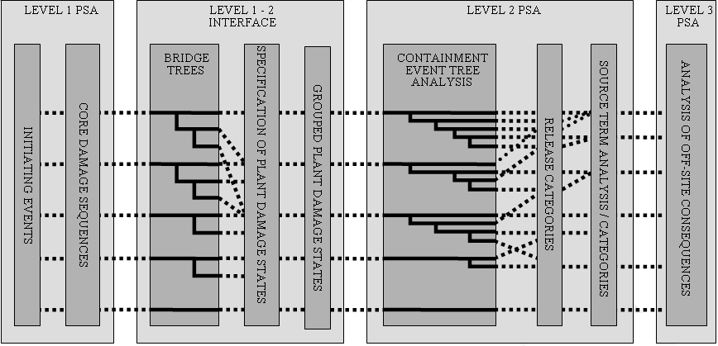
Overview of the development of a typical
Level 2 PSA
Notes:
In Level 2 PSAs, event trees are used to delineate the sequence of events and severe accident phenomena after the onset of core damage that challenge successive barriers to radioactive material release. They provide a structured approach for the systematic evaluation of the capability of a plant to cope with severe accidents. Their use is shown in Fig. 4.1 [6]. Such event trees are termed accident progression event trees (APET) or containment event trees (CET). The term containment event tree is adopted in most Level 2 PSAs, while accident progression event tree, is less frequently used.

Slide 67
Top events and nodal questions of containment event trees
The top events and the nodal questions in a CET address
  the events and physical processes that govern accident chronology,
  plant response to beyond design basis conditions,
  relevant challenges to barriers to radioactive material release and
  the eventual magnitude of the release of radioactive material to the environment.
Nodal questions (success criteria at the nodes of the event tree) of the containment event tree also address issues and actions relating to severe accident management.
The nodal questions of the CET are strongly specific to plant type, i.e. issues of importance to severe accident behaviour in one type of reactor and/or containment system may not be important to others.
Notes:
In many cases the success criteria can only be determined by detailed deterministic calculations or even by series of those. It is also important emphasizing that most of these processes are strongly time dependent, i.e. “dynamic” which feature has to be represented in a way in the event trees, as well.

Slide 68
The structure of containment event trees (CET)
The event tree structure should be
  chronologically correct,
  should properly take into account interdependencies among events and/or phenomena and
  should reflect an appropriate level of detail to satisfy the objectives of the Level 2 PSA.
Regarding chronology it is a common practice to divide the containment event tree into phases sequential in time, with the transitions between phases representing important changes in the issues that govern accident progression, such as:
Phase 1: Immediate response of the plant to the plant damage state caused by the initiating event through the early period of in-vessel core damage.
Phase 2: Late period of in-vessel core damage up to failure of the reactor pressure vessel.
Phase 3: Long term response of the plant. This is also used to be further sub-divided.

Slide 69
Quantification process for CET
The assignment of conditional probabilities to branches of the containment event tree should be supported by documented analyses and data to provide a justified representation of the uncertainty in the outcome at each node.
Several sources of current and relevant information can be used to support the assignment of probabilities, such as:
  Deterministic analyses using established computer codes for modelling severe accidents or basic principles;
  Relevant experimental measurements or observations;
  Analyses and findings from studies of similar plants;
  Expert elicitation involving independent experts.

Slide 70
Physical phenomena
All physical phenomena involved in severe accidents should be considered as far as they influence the challenge to the containment integrity and the fission product source terms.
A typical list of physical phenomena to be considered is the following:
  Core heat-up, degradation and damage, cladding rupture, hydrogen production by cladding oxidation, and flowing down of corium to the vessel bottom;
  Interaction between corium and water in the vessel bottom and in the reactor cavity, in-vessel and ex-vessel steam explosion, blast loads, missile generation, vessel head rupture, interaction between corium and concrete, and non-condensable gas generation;
  Containment pressurization, hydrogen combustion in the containment (laminar and turbulent deflagration, detonation).
  Vessel bottom rupture, corium dispersal into the containment building, core catcher behaviour (if exists), direct containment heating.
These are topics of severe accident deterministic analyses.
Notes:
A compilation of relevant severe accident phenomena can be found in Refs [20, 21]. Developments have taken place in a number of areas, such as:
In-vessel steam explosions (alpha mode containment failure), e.g. Ref. [17];
Direct containment heating, e.g. Ref. [20];
Failure of the lower head of the reactor pressure vessel, e.g. Refs [21, 22];
Flame acceleration and the transition from deflagration to detonation, e.g. Ref. [23].
Physical phenomena must be evaluated using appropriate computer codes, where the phenomena and the events that may appear in the course of the accident are modelled and where the interactions between these phenomena are correctly considered.

Slide 71
Management actions
It is important that actions for severe accident management are reflected in the Level 2 PSA model.
Relevant severe accident management actions that are not represented in the Level 1 model should be incorporated into the CET.
Typically, such actions would be those which are expected later in the chronology of the severe accident sequence, for example,
  refilling of steam generators to reduce releases to the environment via damaged steam generator tubes;
  restarting the low pressure injection after a high temperature induced break in primary circuit boundaries
  filtered venting of the containment and/or continuous heat removal form the containment.

Slide 72
Source term evaluation
The CET provides the conditional probability of a containment failure mode, given an initial PDS.
The CET produces a large number of end states, some of which are either identical or similar in terms of key release attributes.
The end states are often grouped into release categories.
The group of CET in a release category is defined so that the end states are expected to have similar radiological characteristics, thus similar potential off-site consequences. (→ Level 3 PSA)
Notes:
The source term information that the Level 3 PSA requires for each release category covers:
The radionuclides, including also the chemical form of each radionuclide;
The frequency (or frequency distribution) of each release category;
The amount of radionuclides released as a function of time, expressed as fractions of the initial core inventory for each group of radionuclides having similar physical and chemical characteristics;
The time of release, which is relative to reactor shutdown;
The location of release, relative to ground level;
The energy content of release, which is a function of containment temperature and pressure prior to failure;
The particle size distribution of released aerosols, which affect the deposition during plume transport.

Slide 73
Treatment of uncertainties
Similar to Level-1 PSA the Level 2 PSA analysts should identify the dominant sources of uncertainty in the analysis and should quantitatively characterize the effects of these uncertainties on the baseline (point estimate) results that is typically accomplished using sensitivity analysis and uncertainty analysis.
The sources of uncertainty in a Level 2 PSA are numerous and it is impractical to address all of them quantitatively.

Slide 74
Presentation of Level-2 PSA results
Quantitative measures of plant response to severe accidents include:
  Containment performance:
    Conditional probability of containment failure by “mode” (time, size & location).
  Source term:
    Probability of exceedance for source terms of various magnitude,
    Frequency of a release greater than a criterion (For example, “large early” release as defined in by regulators in the USA or the U.K).
Containment performance results
The next figure shows the example of the presentation of the results of containment performance. The breakdown of various containment failure modes could be provided:
  Across total core damage frequency;
  For each PDS;
  For a specific accident sequence.

Slide 75
Containment performance results (example)
Notes:
Containment performance results
Figure shows the example of the presentation of the results of containment performance. The breakdown of various containment failure modes could be provided:
Across total core damage frequency;
For each PDS;
For a specific accident sequence.

Slide 76
Presentation of Level-2 PSA results ‒ cont.
Source terms results
The next figure presents the example of the presentation of the results of source terms analysis.
There are many ways to describe source term results:
  Frequency of exceeding different release magnitude (see next figure);
  Conditional probability of a “large” release (for each PDS or for a specific containment failure mode.

Slide 77
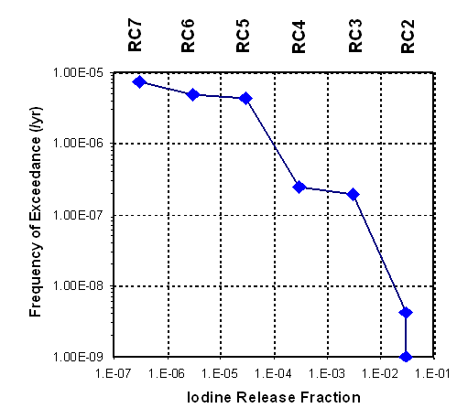
Source term results
Q
Notes:
Figure presents the example of the presentation of the results of source terms analysis.
There are many ways to describe source term results:
Frequency of exceeding different release magnitude (see Figure 4.3);
Conditional probability of a “large” release (for each PDS or for a specific containment failure mode.
(RC – release category)

Slide 78
LEVEL 3 PSA
78
Learning objectives
After completing this chapter, the trainee will be able to:
Define PSA Level 3 objectives.
Define the main steps needed for performing PSA Level 3.
Understand the concept of the atmospheric dispersion and deposition.
Describe the use of meteorological data, exposure pathways, and data on population, agriculture and economy for dose assessment.

Slide 79
Objectives, scope and steps of the PSA Level 3
A PSA Level 3 is needed when probabilistic public safety criteria have been defined by regulatory bodies.
The most commonly used Level 3 safety criteria are:
  individual risks of early and late fatal health effect;
  societal risk of early fatal health effect; collective risks and
  the risk of unacceptable land contamination.

Slide 80
Objectives, scope and steps of the PSA Level 3
‒ cont.
From calculated source terms for the environment with their probabilities for a set of accident sequences as provided by the Level 2 PSA, Level 3 PSA leads to the probabilistic accident consequence assessment of risk to the public (radiological and economic consequences).
Due to current state of the art in this area, releases to the atmosphere are mostly considered, though aquatic contamination is getting currently more attention.

Slide 81
Objectives, scope and steps of the PSA Level 3
‒ cont.
The different steps of evaluation of risks are the following:
  Description of the radionuclides release (including frequency) from PSA Level 2 (source term);
  Atmospheric (aquatic) dispersion and deposition;
  Local and global meteorological (hydrological) data;
  Exposure pathways;
  Population, agricultural and economic data;
  Countermeasures (if any);
  Health effects.

Slide 82
Source term
The expression “source term” (for the environment) covers all characteristics of the release (for each accident sequence or for each group of sequences) that have to be known to calculate all the radiological consequences due to the different exposure pathways.
These characteristics are:
  Time of the release after the beginning of the accident;
  Warning time (time available for possible implementation of protective actions before the release);
  Kinetics of the release for each radionuclide (release rate as a function of time);

Slide 83
Atmospheric dispersion and deposition
The gases, vapours and aerosols are carried by the wind and during this transport, the puffs (or the plume which is the global representation of the successive puffs) grow vertically and horizontally due to atmospheric turbulence, and it is generally assumed that the puffs have a Gaussian profile, characterized by standard deviations (depending on meteorological condition and on distance).
This assumption has been found to be sufficiently valid in many situations and also is easy to model.
Transport and diffusion processes are summarized by the expression atmospheric dispersion.

Slide 84
Meteorological data and sampling of these data
To obtain a probabilistic assessment of the radiological consequences, it is necessary to take into account all the various meteorological conditions during the release.
So, for a specific site, it is necessary to have representative meteorological data recorded on an hourly basis for at least one year.
These data are obtained on the site itself or near the site by a station of the meteorological network.
For long distance calculations and for dispersion models more sophisticated than the Gaussian one, it is required to have recorded meteorological data at several locations around the site, to take into account topographic effects, for example.
Notes:
The meteorological data, for each hour, include:
The wind speed and the wind direction;
The intensity of rain (or indication of no rain);
An indicator of the atmospheric turbulence, generally in the form of “stability class”, such as the classical Pasquill-Gifford classes from A (unstable) to F (very stable).
Different techniques of sampling of these data, for the release sequences, are currently used:
Each hourly condition can be the starting point of the release;
Random sampling of the starting point of the release;
Cyclic sampling (with a chosen time interval);
Stratified sampling, where the meteorological sequences are grouped into a limited number of categories (less time consuming technique).

Slide 85
Exposure pathways and dose assessment
The main exposure pathways, during and after the atmospheric dispersion, are:
  External exposure from the passing puffs (or the passing plume);
  External exposure from the deposited material on the ground;
  Internal exposure by inhalation during the passage of the puffs (generally committed doses to various organs and effective dose);
  Internal exposure by ingestion of contaminated foodstuffs by dry and wet deposition (generally committed doses to various organs and effective dose), firstly by direct contamination and after by root uptake.
For each pathway, dose coefficients (or dose conversion factors) (according to ICRP or IAEA) are to be applied, for each radionuclide, considering the concentration and the conditions (airborne, deposited, contained in a plant, etc.), to determine the individual doses.

Slide 86
Exposure pathways and dose assessment
‒ cont.
Data on population, agriculture and economy
These data are necessary to evaluate the health effects, and to calculate the economic impact of implementing countermeasures like relocation of people and food bans.
Generally these data are available in the form of a radial grid around the site.

Slide 87
Exposure pathways and dose assessment
‒ cont.
Counter measures
Short-term countermeasures include
  sheltering,
  evacuation,
  administration of stable iodine.
Long-term countermeasures include
  relocation of people,
  decontamination of soils (urban and rural areas) and
  food bans for various period of time.

Slide 88
Presentation of the results
Generally, the consequences are evaluated, for each release sequence and for each meteorological sequence, on all the points of a radial grid and this type of calculation is repeated for a sufficiently large number of meteorological sequences in order to take into account all the possible conditions, including the worst.
All the results are ordered to obtain a relative frequency distribution and then the final results are presented as complementary cumulative distribution function (CCDF*)
A point on a CCDF curve gives the conditional (if the accident occurs) probability that the corresponding consequence value is not exceeded.
Q
* Not to be mistaken with the conditional core damage frequency (CCDF) used in PSA Level 1.

Slide 89
PSA FOR EXTERNAL AND INTERNAL HAZARDS
89
Learning objectives
After completing this chapter, the trainee will be able to:
Define internal and external hazards.
Describe the principles of hazard identification and evaluation.
Integrating the hazard PSAs into the Level 1 PSA
Notes:
We have turned back here to Level 1 PSA, again!

Slide 90
Definitions
Apart from random component failures and human errors that may lead to internal initiating events, fault sequences may be caused by the damage imposed by other hazards.
Other hazards can be categorized as follows [SSG-3]:
  Internal hazards originating from sources located on the site of the nuclear power plant, either inside or outside plant buildings; and typically are caused by a failure of a non-safety equipment.
  External hazards originating from the sources located outside the site of the nuclear power plant. These can be either of natural or of human origin.
  Note, that the hazards of human origin which are due to some intentional, malevolent action are not considered here. They cannot be treated in statistical way.

Slide 91
Definitions ‒ cont.
Such hazards can damage plant components and thus generate accident sequences that might lead to core damage (or to other end states as appropriate, if these are considered in the Level 1 PSA).
Often these hazards have the potential to affect many different pieces of equipment simultaneously and adversely impact plant personnel.
Both internal and external hazards should be included in the Level 1 PSA.
Notes:
Important part of Level 1 PSA!

Slide 92
Analysis process and collection of initial information
The main stages of the analysis of internal and external hazards typically include:
  Collection of initial information on internal and external hazards;
  Detailed layout information of the components potentially vulnerable to the hazards;
  Hazard identification, including single and combined hazards;
  Hazard screening analysis, both quantitative and qualitative;
  Bounding assessment; and/or
  Detailed analysis.
While the stages of hazard identification and screening are similar for internal and external hazards, the bounding assessment and detailed analysis for each hazard may involve tasks that may be unique for the hazard considered, e.g. fire propagation will need to be analysed in the case of internal fires.
Notes:
The data collection for the external hazards shall be the most important part of the site evaluation process. As the main result of this process the so called “hazard curves” are to be determined, i.e. the expected hazard magnitude versus the return frequency, or the probability of occurring a hazard with a given magnitude per year.
All potential internal and external hazards that may affect the plant should be considered and should be subjected to screening analysis, bounding assessment or detailed analysis, as appropriate.
At the starting point of PSA for internal and external hazards, all available information specifically relating to the internal and external hazards is collected. This information includes, at a minimum:
Design information relating to internal and external hazards as considered in the safety analysis report;
List and layout of plant buildings, structures, systems and components;
Plant layout and topography of the site and surroundings;
Information on the location of pipelines, transportation routes and
on-site and off-site storage facilities for hazardous materials;
Location of industrial facilities in the vicinity of the site;
Historical information on the occurrence of any internal and external hazards at the site, in the region, etc.

Slide 93
Internal hazards
The task of hazard identification is aimed to generate a comprehensive list of potential internal and external hazards. Examples of specific internal hazards are:
Internal hazards inside plant buildings:
  Internal fires;
  Internal floods;
  Internal missiles;
  Internal explosions;
  Heavy load drops.
Notes:
Typically the policy is that the design shall be such that internal fires and floods may not cause any loss of safety function, i.e. they may cause loosing a single safety train without initiating the need for safety function of the train. Concerning the missiles, the explosions and heavy load drops, the requirement is that these events may only cause any safety issue with a negligible probability, therefore they are not considered within the design basis.
However, that doesn’t meant that the inclusion of these hazards and the events potentially caused by them shouldn’t be included in the PSA analysis, since the main goal of the Level 1 PSA is to determine the frequency of the cases of core damage, which is beyond the design basis.

Slide 94
External hazards
Examples of specific external hazards are:
External natural hazards:
  Seismic hazard;
  External fire;
  External flood;
  High wind;
  Biological phenomena, for instance abnormal fish population in the cooling pond;
  Extreme meteorological conditions (e.g. extreme temperature, extreme rainfall, snow precipitation and ice pack, and lightning).
External human made hazards:
  Off-site explosion;
  Off-site toxic substance release;
  Aircraft crash.
Notes:
External hazards
For the external hazards, it is generally required that the magnitude of the hazard considered within the design basis shall not cause any initiating event, thus the SSCs important to safety should be able to survive the external hazard. This is to be demonstrated in the safety analysis report.
That means that only the magnitudes beyond the design basis are assumed to cause initiating events, though often with multiple failures.

Slide 95
Combined hazards
Combined hazards
The process of identification of hazards should include the identification of all credible combinations of hazards that may be significant for risk.
Note that combinations of hazards may have significantly higher impact on plant safety than each individual hazard considered separately, and
the frequency of occurrence of a combination of hazards may be comparable to that of the individual hazards, e.g. high level water due to storm precipitation and dam failure caused by storm precipitation.
Notes:
The following causes for combinations of hazards should be considered:
Hazards have the potential to occur at the same conditions and at the same time (e.g. high winds and snow precipitation);
One external hazard can induce other (e.g. a seismically induced external flood accompanied by dam failure);
External hazards can induce internal hazards (e.g. seismically induced internal fires or floods);
One internal hazard can induce other internal hazards (e.g. internal floods induced by internal missiles).

Slide 96
Screening of hazards ‒ cont.
A screening process should be applied in a manner that ensures that none of significant risk contributors are omitted.
The following screening criteria, which can be used either individually or in combination, are typically applied:
  If the hazard will not lead to an initiating event. For external hazards, this criterion is generally applied when the hazard cannot occur close enough to the plant to affect it.
  The hazard will be slow to develop and it can be demonstrated that there will be sufficient time to provide an adequate response.
  The hazard has a significantly lower frequency of occurrence and may cause least consequences than other hazards.

Slide 97
Bounding and detailed analyses
Hazards that survive screening should be considered in the frame of a bounding assessment and/or detailed analysis.
It typically includes the following tasks:
  Collection of site and plant information supported, when feasible, by plant walk-downs.
  Hazard characterization: identification of hazards, calculation of hazard frequency or hazard curve and analyses of the impact of hazards.

Slide 98
Bounding and detailed analysis ‒ cont.
It also shall include the following task:
  Integration of the Level 1 PSA for internal and external hazards into the Level 1 PSA :
    Determination of initiating events induced by the hazard;
    Analysis of specific dependencies and common cause failures;
    Analysis of specific data;
    Analysis of specific human reliability aspects.
    Qualitative and/or quantitative screening;
    Quantification of the contribution of the hazards to core damage frequency (analysis of results, sensitivity studies, and uncertainty and importance analyses);
    Documentation (with particular consideration given to assumptions and references used in the analysis including quality assurance).
Q
Notes:
It is important to note that though initiating events caused by external and internal hazards are treated roughly with the same methodology as internal initiating events, they have important specificities that have to be underlined, for instance:
There are very important correlations between the IE, the component failures, the containment behaviour;
Particular components which are not considered in the case of internal IEs because they have a low failure probability, need to be introduced because their failure probability becomes significant in case of internal or external hazards (electrical cables in case of fire, structures in case of earthquake);
Due to these specificities, the treatment of external and internal hazards needs particular analysis, including new event sequences and new system analysis.

Slide 99
LOW POWER AND SHUTDOWN PSA
99
Learning objectives
After completing this chapter, the trainee will be able to
Define plant operational states for which probabilistic safety assessment should be performed.
Describe the difference between PSA for full-power operation and PSA for low power and shutdown states.

Slide 100
General information
It is a general experience that the risks associated with low power and shutdown modes is comparable or even higher than of full power conditions.
The reason is that in low power and shutdown modes the operational configuration and the conditions of the plant change significantly, resulting in reduced number of physical barriers and of automated safety systems:
  Reduced redundancy and diversity of mitigation systems;
  Increased reliance on operator actions;
  Increased susceptibility to fires and floods;
  Reduced containment / confinement integrity.
All elements of the operating cycle shall be covered in the PSA; where the low power and shutdown PSA (LPS PSA) is an essential element of the safety analysis. (See next figure!)
Notes:
Also note, that the internal and external hazards shall also be included in the low power and shut-down PSA.

Slide 101
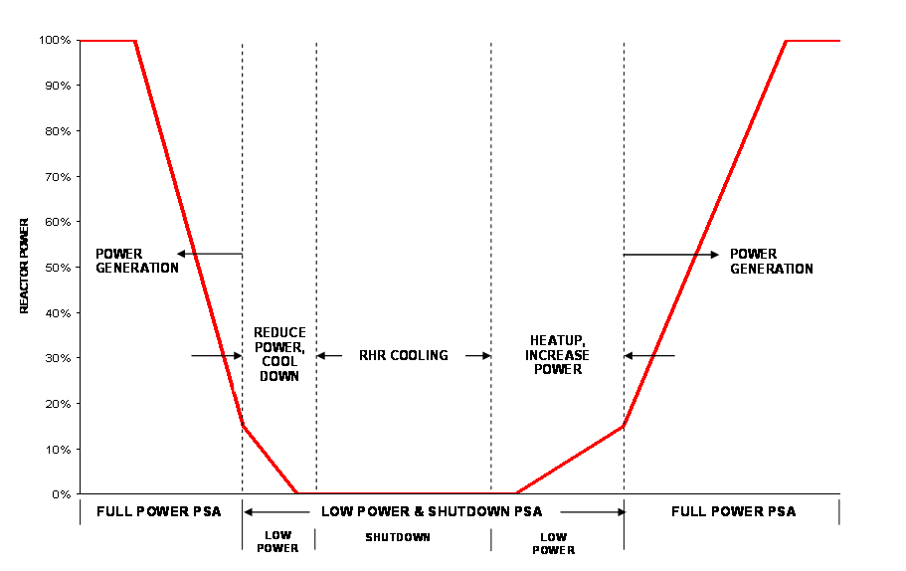
PSA coverage of plant operating modes
Notes:
The scheme in the figure is quite simplified. In practice a much larger number of low power and shut down states are defined for separate analysis, e.g. cases of hot shut down, cold shut down with closed reactor, open reactor with fuel, refuelling, full removal of fuel from the reactor, fuel load, etc.

Slide 102
General information ‒ cont.
The objective of the low power and shutdown PSA is not only the determination of core damage frequency, since the spent fuel may potentially get damaged outside the reactor, as well. Therefore the fuel damage frequency shall be considered.
There are also several important differences from full-power PSA that require special considerations in low power and shutdown PSA, as discussed below.

Slide 103
Types of outages
Generally (for plants where refuelling is carried out off-line), there may be three different types of outages, as follows:
  Regular refuelling outages, during which major maintenance activities are also carried out;
  Planned outages, during which specific, scheduled maintenance activities are carried out;
  Unplanned outages that follow a disturbance or event.

Slide 104
Plant operational states (POS)
The major specificity of the low power and shutdown PSA is that a large number and variety of plant configurations exist that would, if handled individually, lead to an excessive number of scenarios to be analysed.
For dealing with the variety of plant operational states, a limited number of plant configurations is specified for which the plant status and configuration are sufficiently stable, well defined and representative.
Notes:
The use of term: “operational states” in the textbook is incorrect, since it is a defined term with different meaning. The term “plant operational states” is generally used in LPS PSA, which is not to be confused with the term “plant states” (as it is defined in the IAEA Glossary, and also in the Module 6 material).
In practice, in Level-2 PSA 10-25 POSs are defined and analysed.

Slide 105
Plant operational states (POS) ‒ cont.
The following physical and technical aspects of the plant states are typically taken into account while defining plant operational states:
  Reactor criticality (and/or shutdown margin);
  The level of decay heat;
  Temperature and pressure in the reactor coolant system;
  Water level in the primary system;
  Open or closed reactor coolant system;
  Operability status of loops in the reactor coolant system;
  Location of the fuel;
  Availability of safety systems and support systems, including consideration of whether they are controlled automatically or by manual actions;
  System alignments;
  Status of the containment integrity.

Slide 106
Initiating events analysis
As compared to the FP PSA, there are additional and different types of IEs to be considered in LPS PSA.
  The plant procedures shall be studied to determine the plant configuration, especially that of the RCS; the testing and maintenance activities. These are essential in the initiating events analysis and also influence the fault trees substantially.
Increased potential for human-induced initiating events and malfunctions.
  misalignment, unwitting skip of a procedure step,
  communication error among the personnel,
  negligence, etc.
Notes:
Thus the examination of plant procedures for changing RCS configurations, testing and maintenance is essential in the initiating events analysis for low power and shutdown PSA.

Slide 107
Initiating events analysis
Initiating events grouping in POSs
Groups of initiating events may be different in different POSs:
  Some initiating events may occur during many (or all) POSs;
  Some initiating events depend on specific POS (e,g. testing and maintenance, fuel handling activities).
Therefore each IE should be analysed for it’s applicability for specific POS in the grouping process.

Slide 108
Comparative summary on the aspects important for HRA
Full-Power PSA | Shutdown PSA
Short time windows ~0.5hr | Long time windows ~0.5 - 10 hrs
Multiple alarms | Fewer alarms
Clearer indications | Less clear indications, temporary instrumentation
Symptom-based EOPs | Relaxed procedures
Simulator, classroom training | Limited training
Misdiagnosis generally not considered | More possibility for misdiagnosis
Most actions in MCR | Coordination of MCR and local actions
Human errors ~10% of CDF | Human errors ~80% of CDF
Notes:
Table provides comparative summary on the aspects important for HRA in full power and shutdown conditions.

Slide 109
PSA APPLICATIONS
109
Learning objectives
After completing this chapter, the trainee will be able to:
Describe the applications of probabilistic safety assessments for the assessment of the overall plant safety.
Describe the applications of probabilistic safety assessments in NPP operation.
Describe the applications of probabilistic safety assessments for the evaluation of plant modifications.
Describe the applications of probabilistic safety assessments for risk evaluations and for evaluation of regulatory decisions.

Slide 110
Safety assessment
Assessment of the overall plant safety at design and licensing
The assessment of the overall plant safety is the main purpose of PSA performance including identification and ranking of:
  important design and operational features,
  dominant accident sequences, systems, components, human interactions and
  dependencies important for safety.
A comparison of the results against probabilistic safety goals or quantitative health objectives.

Slide 111
Safety assessment ‒ cont.
Periodic safety review
The repeated PSA may deliver useful insights in identifying safety issues, determining their safety significance and making decisions on the need for corrective measures, modifications.
A major benefit of including PSA in periodic reviews is the creation of an up-to-date overview of the whole plant.
PSA may help in identifying cost-effective improvements to safety.
The important issues in this application are:
  the use of actual plant-specific data,
  modelling of as-built-as-operated plant conditions, and
  addressing the possible impact of aging phenomena and component lifetime considerations on the overall risk metrics.

Slide 112
NPP operation
NPP maintenance
Maintenance program optimization. The application includes:
  assessment, optimization and
  establishment of maintenance plans and procedures in view of plant risk.
Focus on equipment with greatest impacts on plant risk:
  check if risk significant systems and equipment are being adequately maintained to support required reliability, or if
  maintenance activities do not reduce plant safety, instead increase risk by resulting in increased equipment unavailability.
The risk informed maintenance may provide reduced or eliminated maintenance tasks for SSCs that have low risk significance and for maintenance that does not support critical functions of the SSCs.

Slide 113
NPP operation ‒ cont.
Accident mitigation
Development and improvement of the emergency operating procedures: The systematic assessment of plant vulnerabilities and the insights derived from the PSA process are used to establish or improve the EOPs and SAMGs by providing assurance that a broad scope of vulnerabilities is addressed in a
  realistic,
  appropriately detailed and
  consistent manner.

Slide 114
NPP operation ‒ cont.
Emergency planning
Support for NPP emergency planning: Based on PSA, important elements of emergency planning are explored and appropriate strategies are developed.
The issues to be explored are:
  the characteristics of the plant,
  the plant site and
  the different possible countermeasures, such as:
    sheltering,
    evacuation,
    iodine prophylaxis,
    long-term relocation,
    land decontamination, food bans).
This requires a Level 3 PSA.
Notes:
Accident mitigation and emergency planning
Support for NPP emergency planning: Based on PSA, important elements of emergency planning are explored and appropriate strategies are developed. The issues to be explored are: the characteristics of the plant, the plant site and the different possible countermeasures (such as sheltering, evacuation, iodine prophylaxis, long-term relocation, land decontamination, food bans).

Slide 115
NPP operation ‒ cont.
Personnel training
Improvement of operator training program: PSA is used to improve operator training program by providing information on
  the accident processes,
  the relative likelihood of the dominant accident sequences, and
  the associated operator actions required to prevent or mitigate core damage.
Improvement of maintenance personnel training program: Training of maintenance staff is enhanced based on insights and information from the PSA.
This results in an increased focus on risk-significant SSCs and on risk-significant functions and failure modes that must be addressed in the maintenance program as well as opportunities to optimize maintenance tasks that are not significant to risk management.

Slide 116
Permanent changes to the operating plant
Plant changes
NPP upgrades, back-fitting activities and plant modifications: Identification of weaknesses and effective areas for improvement in plant design and operational features in view of plant risk.
PSA arguments are used to support the selection, design, implementation, justification, and licensing of plant upgrades.
Life time extension: The application is often referred as a sub-case of the periodic safety review with the consideration of aging effects beyond the design lifetime.
It involves modelling of aging effects in PSA.

Slide 117
Permanent changes to the operating plant ‒ cont.
Technical specification changes
Determination and evaluation of changes to allowed outage time and changes to required TS* actions: Required actions in TS have been typically derived on a classical engineering basis.
Some items can be re-evaluated by PSA and changed eventually according to risk-significance.
In addition, the PSA may be used to support the optimization of maintenance tasks with respect to whether they must be done during outages or whether on-line maintenance is appropriate.
Risk-informed optimisation of TS: The TSs define limits and conditions for operation, testing, and maintenance activities as a way to assure that the plant is operated safely.
From time to time, the plant operator may need a TS exemption due to operational burdens and constraints.
* Technical Specification is the USA term for Operational Limits and Conditions

Slide 118
Evaluation of safety issues ‒ cont.
Regulatory decisions
Long-term regulatory decisions: PSA insights are used to guide long-term prioritization of regulatory objectives and requirements, and of related safety research.
PSA results are used to develop risk insights, and strategies to maintain or reduce risk levels are devised.
Change in risk metrics are used to evaluate possible changes to requirements needed to implement the risk management strategy.
Interim regulatory decisions: PSA is used to alleviate a regulatory concern, while longer-term solutions can be evaluated.
Issues that typically require an interim decision are:
  (a) need for regulatory action in response to an event at a plant,
  (b) one-time exemptions from TS or other licensing requirements, and
  (c) temporary modifications to hardware configuration or procedures.
Q

Slide 119
Summary
We have been discussing:
The role and the main goals of the probabilistic safety assessment
Definition and roles of the different levels of PSA
The significance of the specific analyses for the different plant operational states (POS)
The significance of the evaluation of different hazards by PSA
Some of the most important applications of PSA

Slide 120
Key points
The role and methodology of PSA
The 3 levels of PSA
Applications of PSA

Slide 121
List of abbreviations
APET – Accident progression event tree
CCDF – Conditional core damage frequency
CCDF – Complementary cumulative distribution function
CCF – Common cause failure
CD – Core damage
CDF – Core damage frequency
CET – Containment event tree
EOP – Emergency operating procedures
ET – Event tree
FMEA – Failure mode and effect analysis
FP PSA – Full power PSA
FSAR – Final safety analysis report
FT – Fault tree
HRA – Human reliability analysis
ICRP - International Commission on Radiological Protection
IE – Initiating event
OLC – Operational limits and conditions
PDS – Plant damage state
POS – Plant operational states (modes of normal operation)
SAMG – Severe accident management guideline
SSC- Systems, structures and components
TS – Technical specification (same as OLC)

Slide 122
References
INTERNATIONAL ATOMIC ENERGY AGENCY, Terminology Used in Nuclear Safety and Radiological Protection 2007, IAEA Safety Glossary, IAEA Vienna (2007).
EUROPEAN ATOMIC ENERGY COMMUNITY, FOOD AND AGRICULTURE ORGANIZATION OF THE UNITED NATIONS, INTERNATIONAL ATOMIC ENERGY AGENCY, INTERNATIONAL LABOUR ORGANIZATION, INTERNATIONAL MARITIME ORGANIZATION, OECD NUCLEAR ENERGY AGENCY, PAN AMERICAN HEALTH ORGANIZATION, UNITED NATIONS ENVIRONMENT PROGRAMME, WORLD HEALTH ORGANIZATION, Fundamental Safety Principles, IAEA Safety Standards Series SF-1, IAEA, Vienna (2006).
INTERNATIONAL ATOMIC ENERGY AGENCY, Safety of Nuclear Power Plant: Design, SSR-2/1 (Rev. 1.), IAEA, Vienna (2016)
INTERNATIONAL ATOMIC ENERGY AGENCY, Safety of Nuclear Power Plant: Commissioning and Operation, SSR-2/1 (Rev. 1.), IAEA, Vienna (2016)
INTERNATIONAL ATOMIC ENERGY AGENCY, Safety Assessment for Facilities and Activities, General Safety Requirements Part 4 (Rev. 1.) IAEA, Vienna (2016)
INTERNATIONAL ATOMIC ENERGY AGENCY, Development and Applications of Level-1 PSA, Safety Standards Series No. SSG-3, IAEA, Vienna (2010).
INTERNATIONAL ATOMIC ENERGY AGENCY, Development and Applications of Level-2 PSA, Safety Standards Series No. SSG-4, IAEA, Vienna (2010).
Notes:
There are more references in the Textbook.

Slide 123
QUESTIONS for discussion
What are the main goals/outcomes of probabilistic safety assessments?
What is the scope of probabilistic safety assessments and which are the levels of probabilistic safety assessments?
Name plant operational states for which probabilistic safety assessments are performed.
Which initiating events and hazards have to be taken into account when performing probabilistic safety assessments?
What are PSA Level 1 objectives?
What is the concept of fault trees and event trees?
What is the concept of common cause failures and human reliability analysis?
◄
Notes:
These are suggested questions for the presenter in order to enhance the perception of the audience.
Reference slides for the questions:
– Slides 6,8,10
- 12-14.
- 100-105
- 23-25 and 93-95
- 12 and 19
- 27-31
- 38, 41,42

Slide 124
QUESTIONS ‒ cont.
What are PSA Level 2 objectives?
What are the general steps undertaken when performing Level 2 PSA?
Describe briefly the PSA Level 1 to PSA Level 2 interface.
Describe the notion of source term?
What are PSA Level 3 objectives and which are the main steps needed for performing PSA Level 3?
Why do we need the atmospheric dispersion and deposition models?
How do we use the meteorological data, exposure pathways, and data on population, agriculture and economy for dose assessment?
Name few applications of probabilistic safety assessments.
◄
Notes:
- 59-60
- 61
- 62-63
- 59, 61
- 79-81
- 83
- 84-85
- 114-118

Slide 125
Thank you!
Notes:
Thank you!

